Slide 1
Supernovae
Anand M. Kamble
(amk23j@fsu.edu)
Prof. Xiaoqiang Wang
(wwang3@fsu.edu)
Department of Scientific Computing, Florida State University
February 25th, 2024

Slide 2
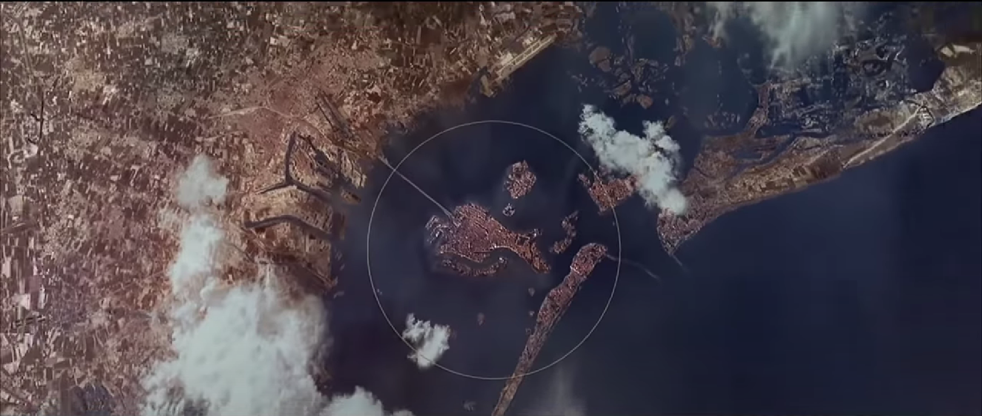
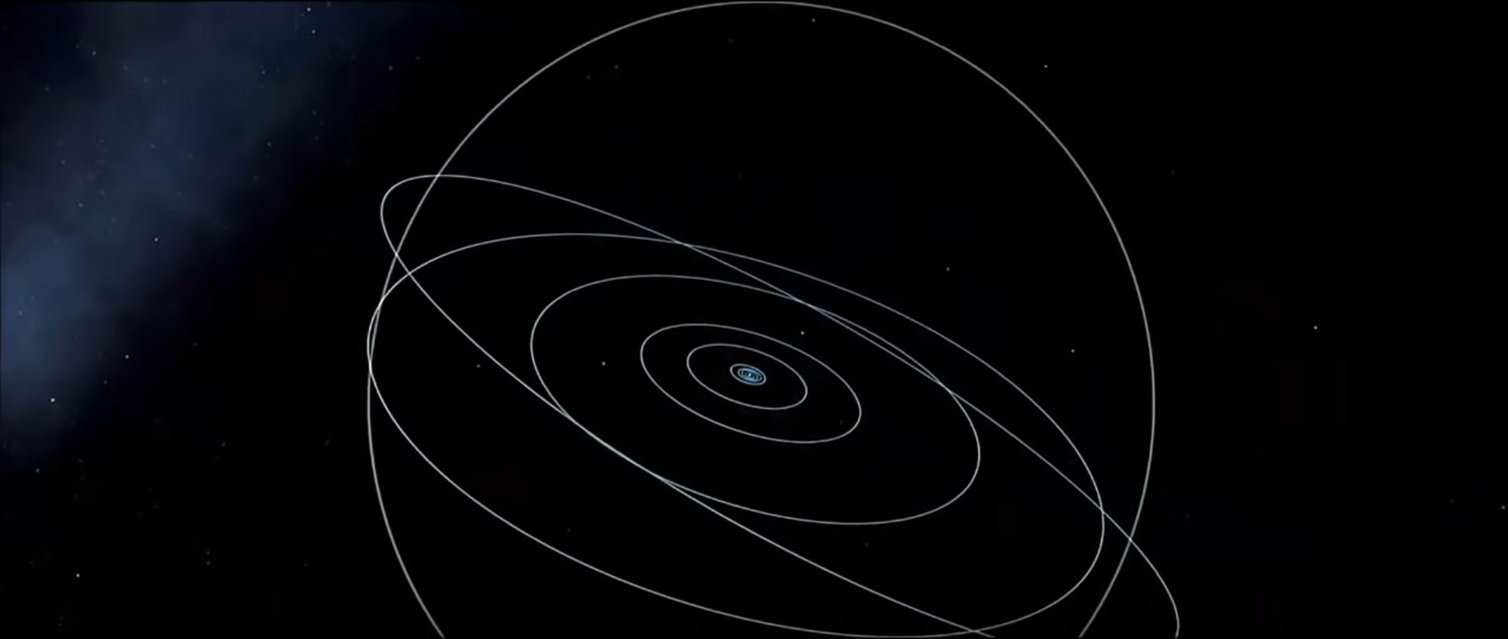
Background Methods Results Next Steps
Problem Statement
Visualizing HDF5 dataset
Rapid changes in scale of data
Time varying dataset
Powers of Ten (film)
Department of Scientific Computing, Florida State University
2 / 15
Notes:
SO the given dataset is in the hdf5 format, also The given data set is split into 100 timeslices. And it is rapidly changing it’s scale over time. That is from ranging from few kilometers to hundreds of million kilometers.
Which means it’s going from being a size of a city to being as large as the orbits of the planets.

Slide 3
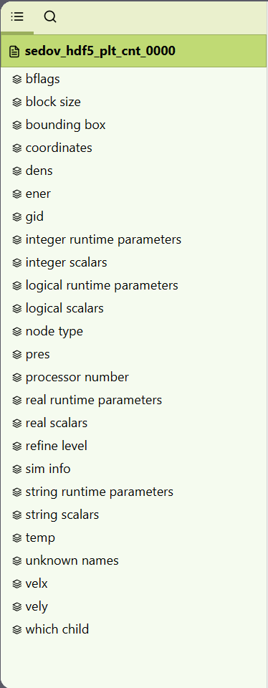
Background Methods Results Next Steps
Dataset
2D Dataset
https://myhdf5.hdfgroup.org/
Department of Scientific Computing, Florida State University
3 / 15
Notes:
If we look at all the available fields in this dataset, we can see there are a lot of those.

Slide 4
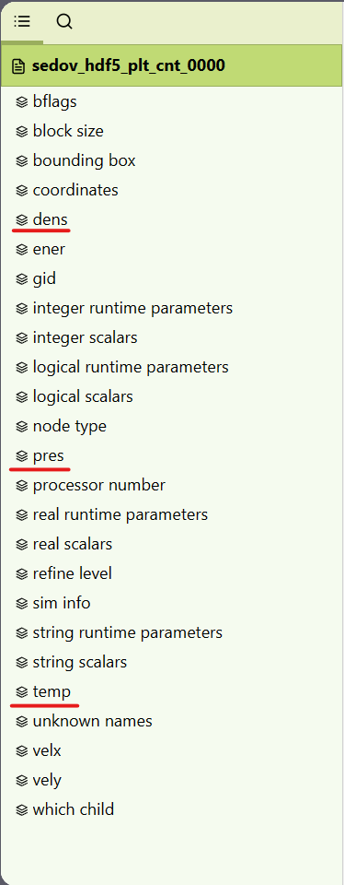
Background Methods Results Next Steps
Dataset
Density
Pressure
Temperature
https://myhdf5.hdfgroup.org/
Department of Scientific Computing, Florida State University
4 / 15
Notes:
If we look at all the available fields in this dataset, we can see there are a lot of those.
But we are only interested in these ones, density, pressure and the temperature. For this project we will be only focusing on this fields.

Slide 5
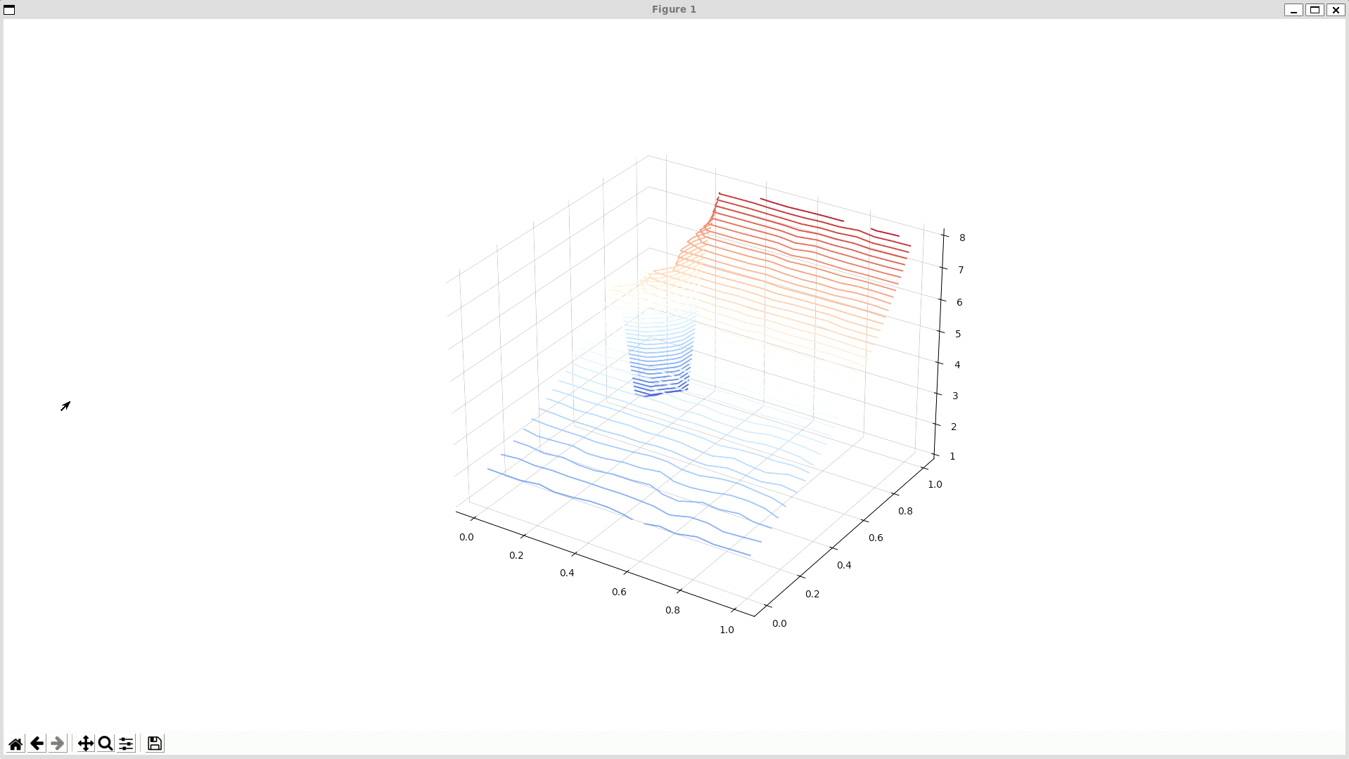
Background Methods Results Next Steps
Experiments
Using Matplotlib
Department of Scientific Computing, Florida State University
5 / 15
Notes:
First of all, I wanted to understand how the data is structured, so I converted the HDF5 data into an numpy array, and then plotted a contour plot of the density using matplotlib.

Slide 6

Background Methods Results Next Steps
Experiments
Trials with VTK
Building the module of VTK for C++
Department of Scientific Computing, Florida State University
6 / 15
Notes:
Then I first started the project with VTK, in C++, but soon I realized that it’s too complicated and I was not able to build the required VTK module for C++, So I went back to python, and

Slide 7
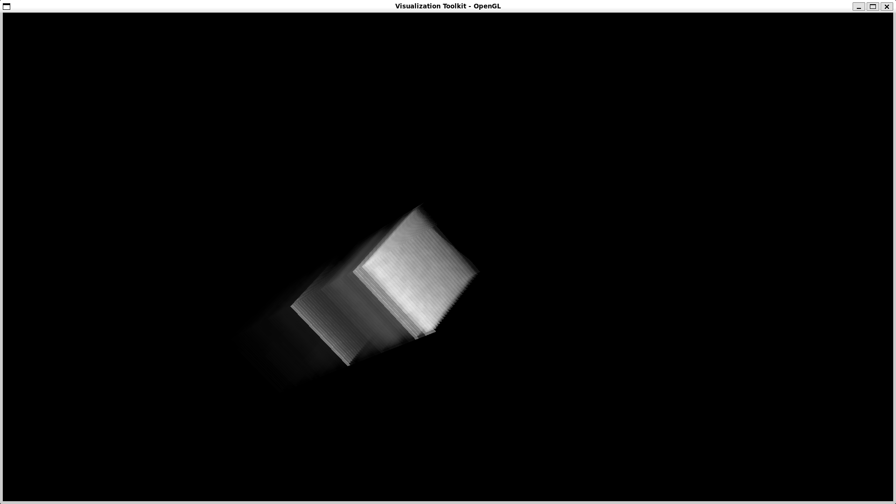
Background Methods Results Next Steps
Experiments
VTK python module
Department of Scientific Computing, Florida State University
7 / 15
Notes:
was able to get some renders after processing the data using numpy, I tried doing volumetric rendering which kind of works but it’s very hard to understand anything from this.

Slide 8
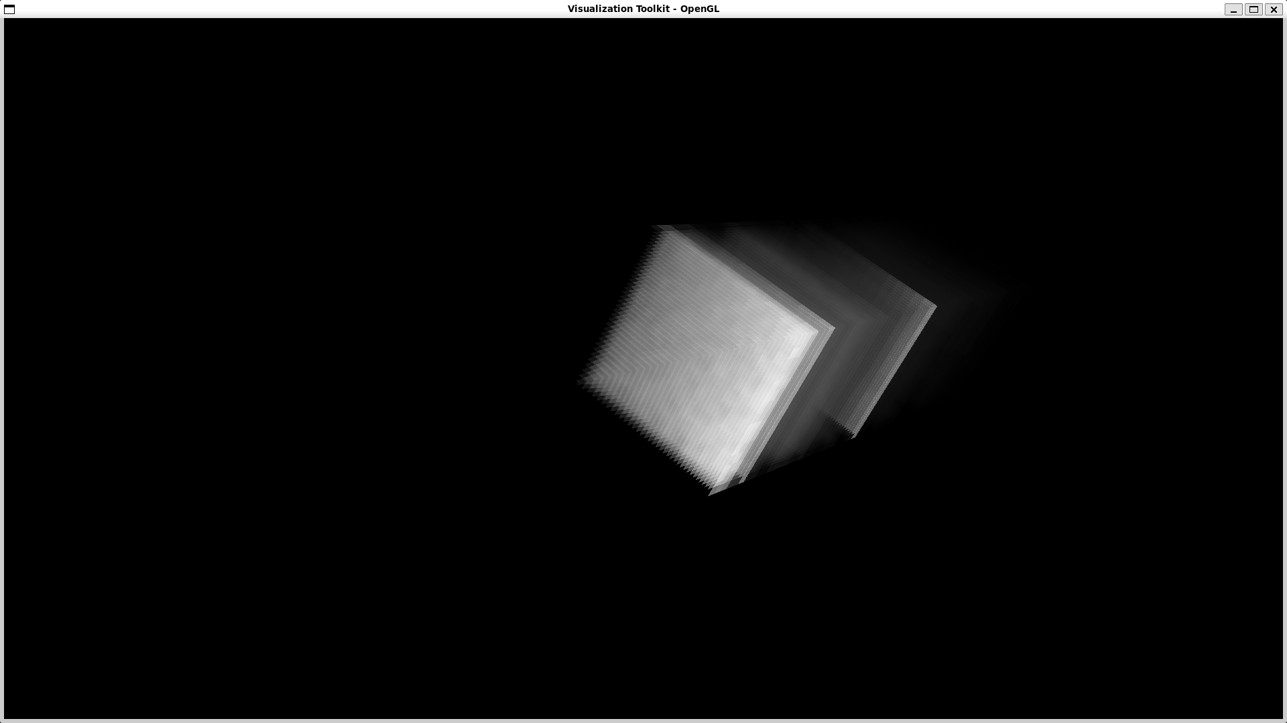
Background Methods Results Next Steps
Experiments
VTK python module
Department of Scientific Computing, Florida State University
8 / 15
Notes:
And here’s another angle to that amazing render of density.

Slide 9

Background Methods Results Next Steps
Visit
Open source software
Viewing and analyzing scientific data on scalar and vector fields across 2D and 3D meshes
Department of Scientific Computing, Florida State University
9 / 15
Notes:
So I finally decided to use Visit, which make everything a lot easier.
It’s an open source software and mainly used for viewing and analyzing scientific data

Slide 10
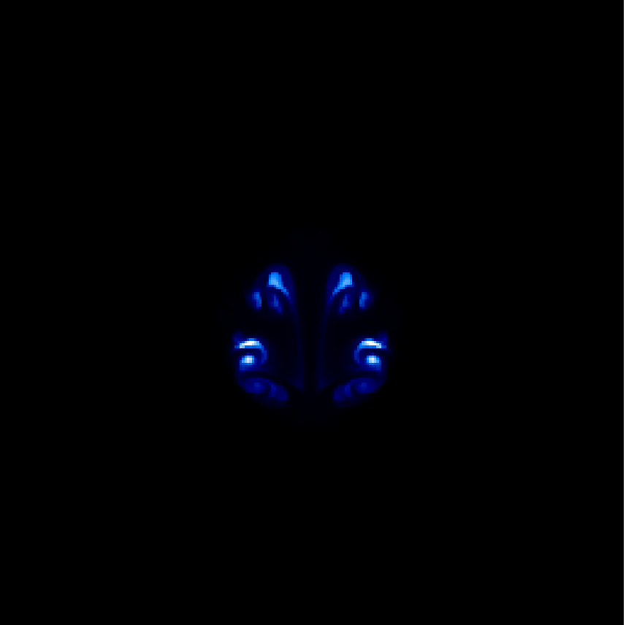
Background Methods Results Next Steps
Visit
Using FLASH plugin for reading the dataset.
Drawing the plots with Pseudocolor.
Some plots are using logarithmic scale.
Creating movies using ffmpeg
Department of Scientific Computing, Florida State University
10 / 15
Notes:
In Visit, I am using the FLASH plugin to read the dataset, and then drawing the plots using Psudocolor, some plots like density are using logarithmic scale for better visualization of the changes.
For some reason Visit was not saving a video but was saving seperates frame as png images, so I use ffmpeg to convert it into MP4 video.
Render you see here on the right, is one of the frames from the energy plot.

Slide 11
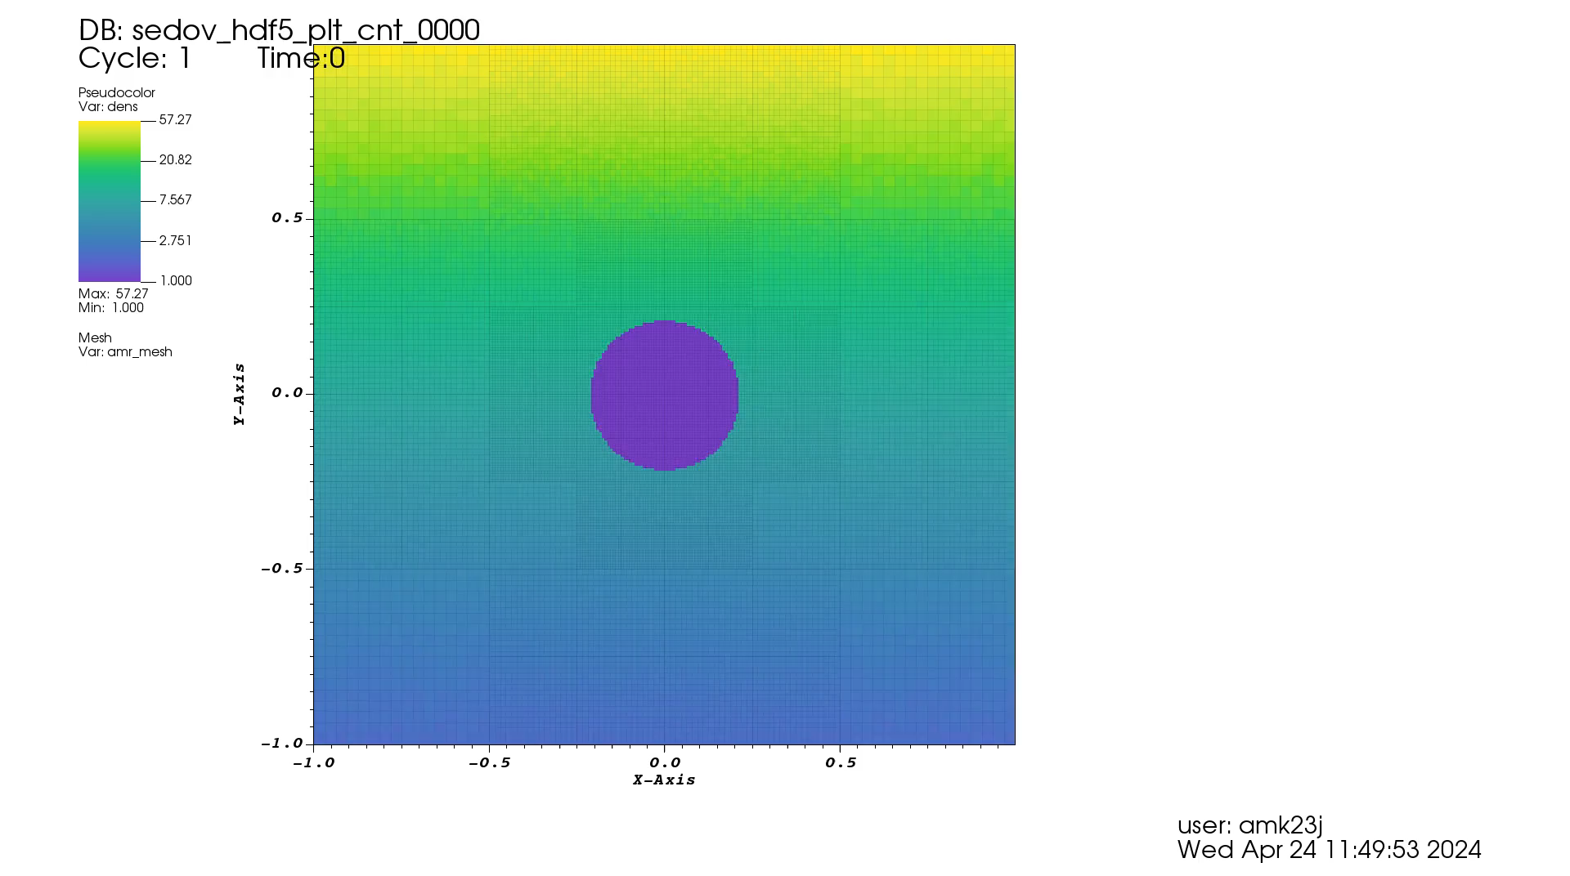
Background Methods Results Next Steps
Density
Department of Scientific Computing, Florida State University
11 / 15
Notes:
In this movie you can see how the density progresses over time. You can see that the range of values of from 10^-3 to 57 and there is a lot happening in between 1 and 10, so I have used logarithmic scale for this field.

Slide 12
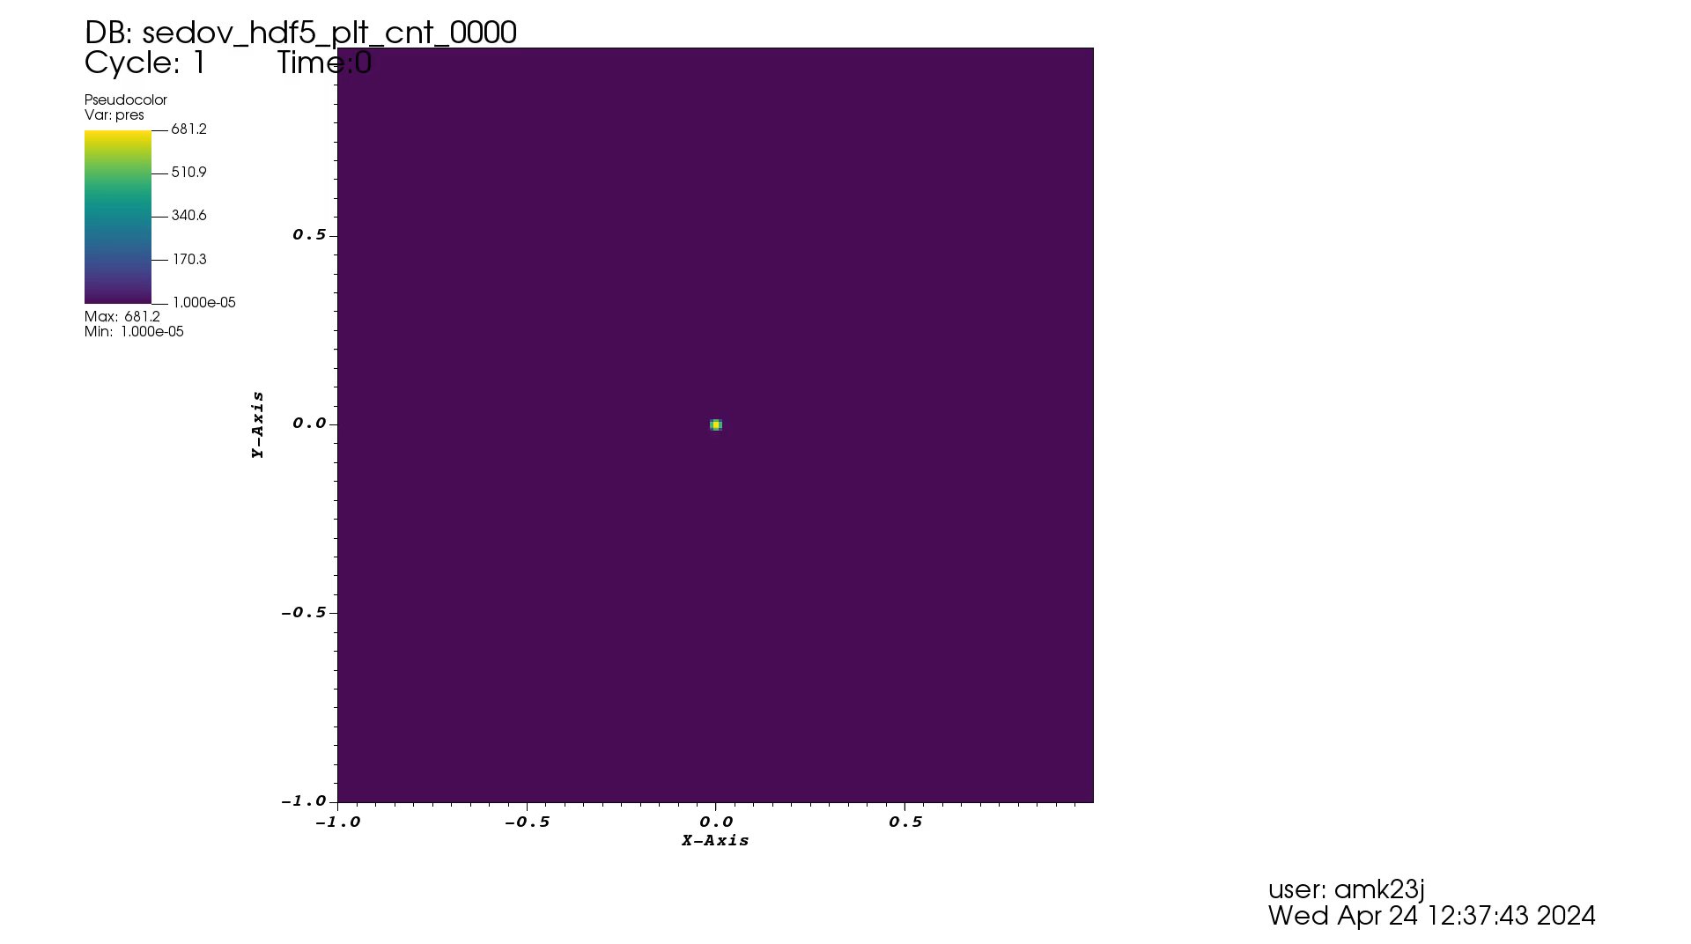
Background Methods Results Next Steps
Pressure
Department of Scientific Computing, Florida State University
12 / 15
Notes:
When it comes to pressure, we can see a shock wave travelling outwards in this explosion which is highlighted by the yellow color.

Slide 13
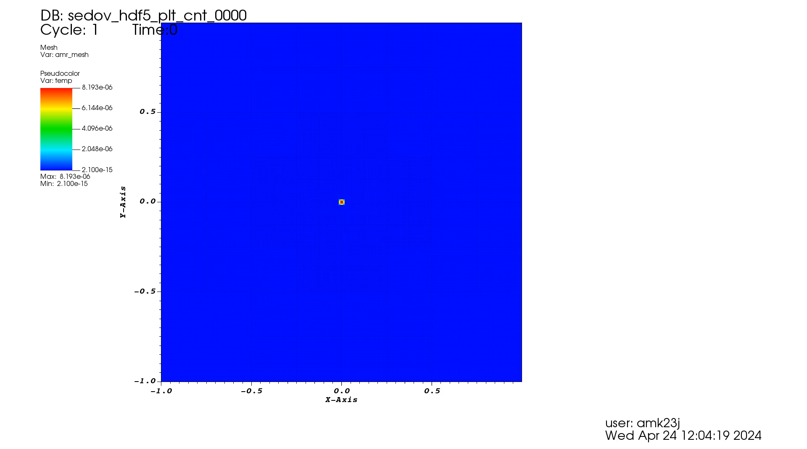
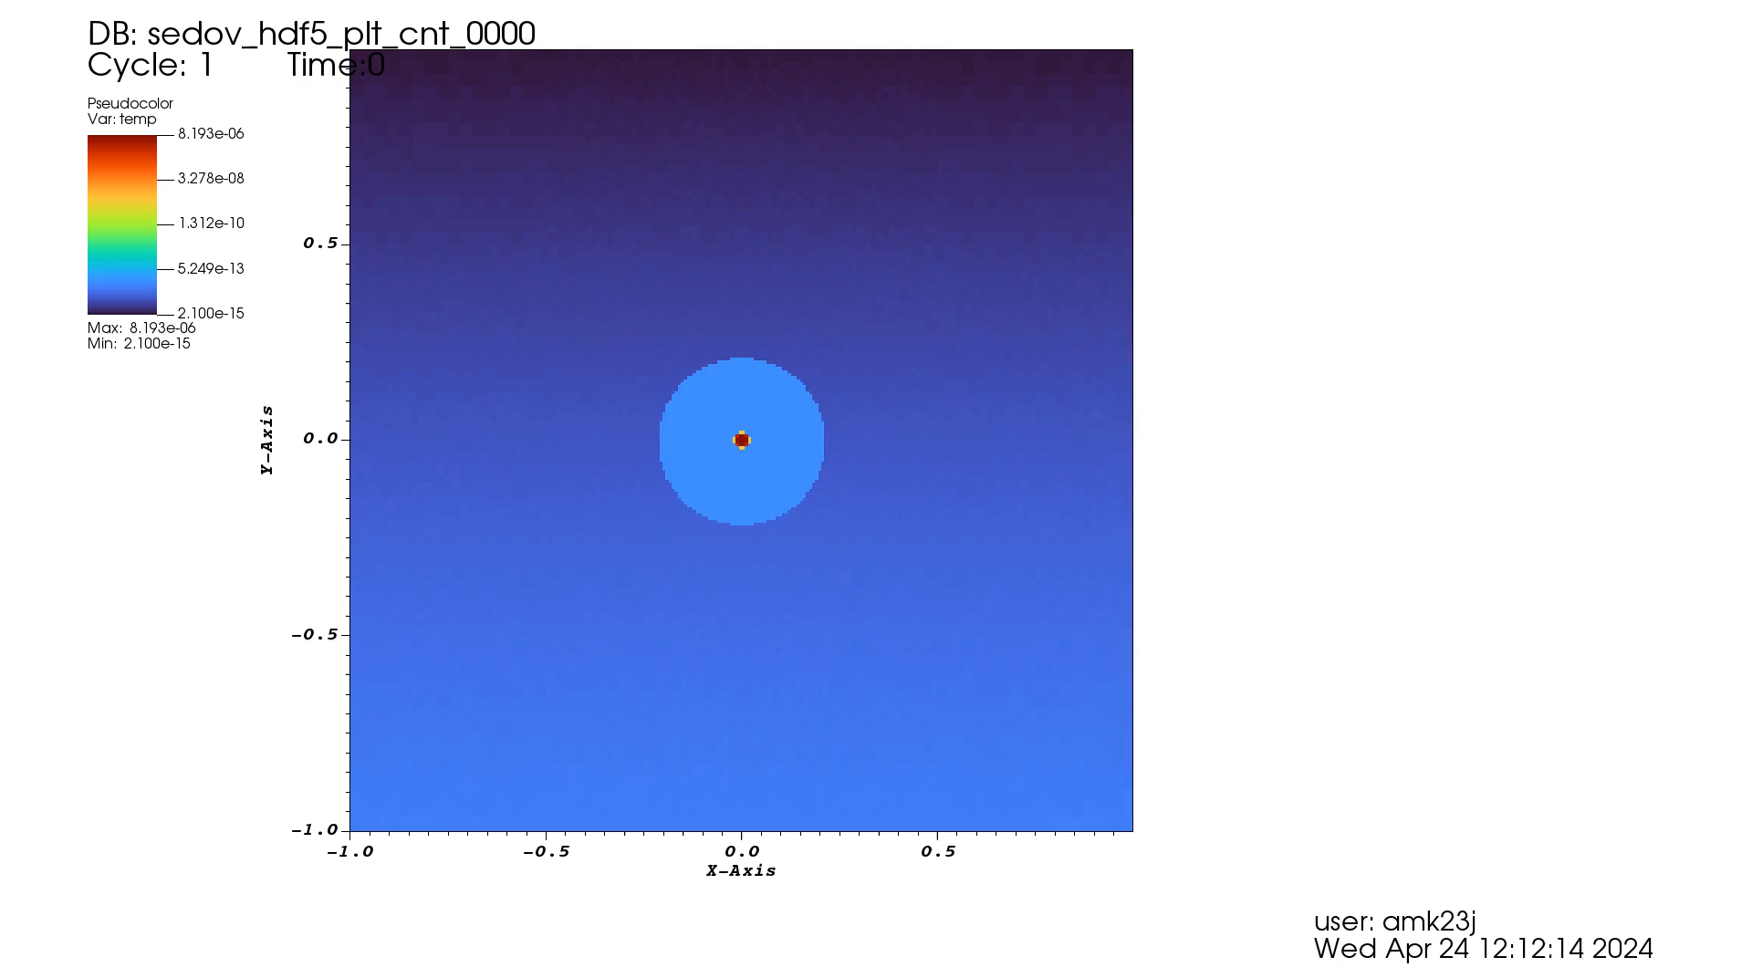
Background Methods Results Next Steps
Temperature
Department of Scientific Computing, Florida State University
13 / 15
Notes:
For temperature I have two plots, one on the left is linear scale and one on the right is using logarithmic scale, we can see everything that is happening with temperature in the logarithmic plot, but it’s difficult to identify the hot spots which are easily highlighted in the linear plot.

Slide 14
Background Methods Results Next Steps
Visit Script
Automate this visualization by a Visit Script.
# Import the necessary modules
import visit
# Open the data file
visit.OpenDatabase("dataset/*",0,"FLASH")
# Add a plot
visit.AddPlot("Pseudocolor", "dens")
# Set the plot attributes
pc = visit.PseudocolorAttributes()
pc.colorTableName = "Hot"
pc.min = 0
pc.max = 10
visit.SetPlotOptions(pc)
# Draw the plot
visit.DrawPlots()
# Set the view
visit.View3DAtts = visit.View3DAttributes()
visit.View3DAtts.viewNormal = (0, 0, 1)
visit.View3DAtts.focus = (0, 0, 0)
visit.View3DAtts.viewUp = (0, 1, 0)
visit.View3DAtts.parallelScale = 17.3205
visit.View3DAtts.nearPlane = -34.641
visit.View3DAtts.farPlane = 34.641
visit.View3DAtts.perspective = 1
visit.SetView3D(visit.View3DAtts)
# Save the plot
visit.SaveWindow()
Department of Scientific Computing, Florida State University
14 / 15
Notes:
As next step I will be creating a script to render to these movies from the dataset. My current script is only generating images.

Slide 15
Background Methods Results Next Steps
Thank you!!
Department of Scientific Computing, Florida State University
15 / 15
Notes:
As next step I will be creating a script to render to these movies from the dataset. My current script is only generating images.

